Slide 1

Covid-19 Classification using CXR
Professors:
Prof. Cosimo Distante
Prof.Pier Luigi Mazzeo
By:
Ahsan Raza
Adriano GARCÍA-GIRALDA MILENA

Slide 2
Motivation
Global pandemic hitting humanity till this date.
Pandemic pressurized the healthcare worker & resources.
RT-PCR is used to detect covid and take 2 days for result.
RT-PCR has high percentage of false negative.
A tool to diagnose covid-19 could reduce this pressure.
Covid-19 can also be detected using CXR and CT.
CXR is used to detect Pneumonia b/c its rapid, inexpensive and less exposure to radiations.

Slide 3
Motivation
Thorough examination of CXR is needed to detect Covid-19.
To reduce time and effort, automation of this process was needed.
This tool takes input of an Chest X-ray image and make predictions between 4 classes i.e. Covid, Lung Opacity, Normal & Viral Pneumonia.

Slide 4
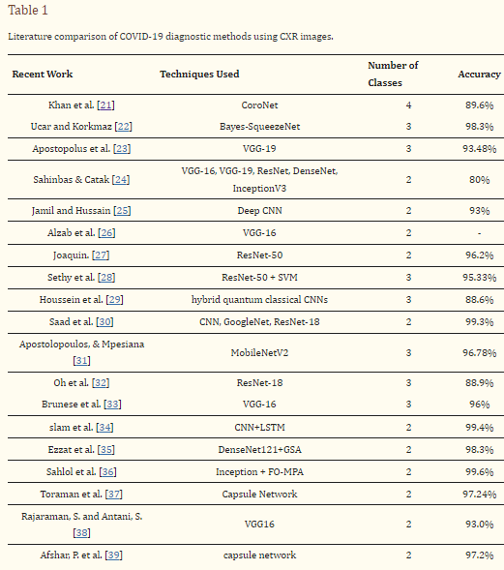
State of the art
The inspiration is taken from following paper :https://www.ncbi.nlm.nih.gov/pmc/articles/PMC8872326/
A paper published online 2022 Feb 10. In which we saw the following table:
CoroNet 4 classes https://www.ncbi.nlm.nih.gov/pmc/articles/PMC7274128/
Dataset is taken from Kaggle: https://www.kaggle.com/code/derrelldsouza/multi-class-x-ray-covid19-classification-94-acc/notebook

Slide 5
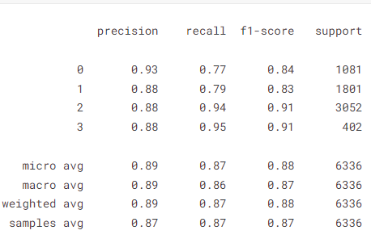
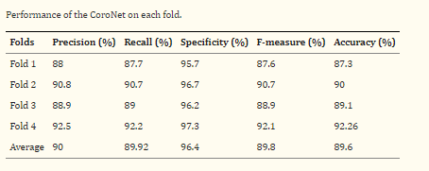
State of the art comparaison
Here we can see a Kaggle model that claimed to have 94%.But was on training set.
Even the best in Kaggle performed worse than CoroNet.

Slide 6
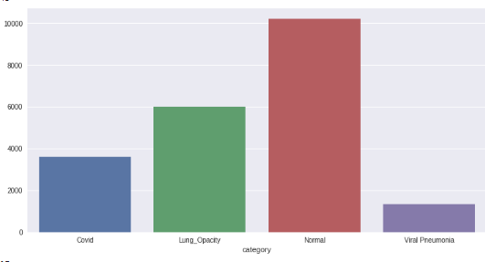
Dataset
The dataset is retrieved from publically available resource: https://www.kaggle.com/datasets/tawsifurrahman/covid19-radiography-database
The dataset contains 21165 images. Splitted in the following way:
3616 Covid
10192 Normal
6012 Lung Opacity
1345 Viral Pneumonia

Slide 7
Dataset
The Data is splitted into Training ,Validation and Test with 70% , 20% , 10% respectively.
Category | Number of Images
Training | 14815
Validation | 4235
Testing | 2115

Slide 8
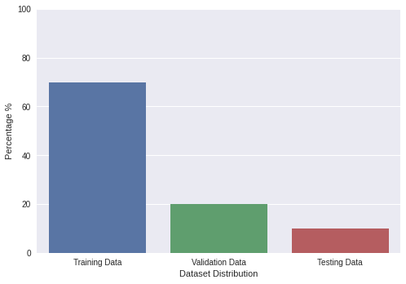
from sklearn.model_selection import train_test_split
train_data, test_valid_data = train_test_split(df, test_size=0.3, random_state = 42, shuffle=True, stratify=df['category'])
valid_data,test_data= train_test_split(test_valid_data, test_size=0.333, random_state = 42, shuffle=True, stratify=test_valid_data['category'])

Slide 9
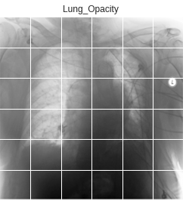
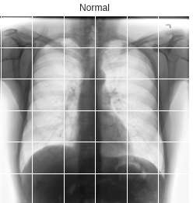
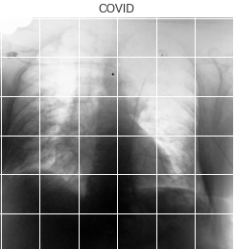
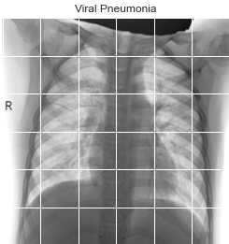
Dataset Samples

Slide 10
Pre-processing of Data
Data Augmentation is done before training the model.
Tensorflow Keras ImageDataGenerator class is used.
It gives us possibility of loading the data into batches during the training.
train_data_gen=ImageDataGenerator(featurewise_center=True,
#Set input mean to 0 over the dataset.
featurewise_std_normalization=True,
#Divide inputs by std of the dataset.
rotation_range=20,width_shift_range=0.2,
height_shift_range=0.2,
horizontal_flip=True)

Slide 11
Model - Resnet50
ResNet bypass connections in the network, allows the gradient to flow without getting multiplied with weight matrices several times.
We don’t import any pre-calculated weights as the weights are calculated on real world images which give low accuracy.
We used Resnet50 model , stripping the fully connected layers at the end and adding some additional layers.
base_model = ResNet50(input_shape= (224,224,3), weights = None, include_top=False)
x=base_model.output
x=GlobalAveragePooling2D()(x)
x = Dense(128, activation='relu')(x)
x = Dense(64, activation='relu')(x)
out=Dense(4,activation='softmax')(x)
Rest_NetModel=Model(inputs=base_model.input,outputs=out)

Slide 12
Training supervision
Rest_NetModel.compile(optimizer=Adam(learning_rate=0.001),loss='categorical_crossentropy',metrics=['accuracy'])
We used categorical_cronssentropy as loss function as its multi-class classification tasks.
To avoid overfitting of model, we use keras EarlyStopping API to monitor the val_accuray for maximum value.
If it does not maximize for 8 epochs (patience), the training will be halted.
tf.keras.callbacks.EarlyStopping(monitor='val_accuracy', mode='max', patience=8)
We use keras API ReduceLROnPlateau to reduce the learning rate when val_accuracy is not improving.

Slide 13
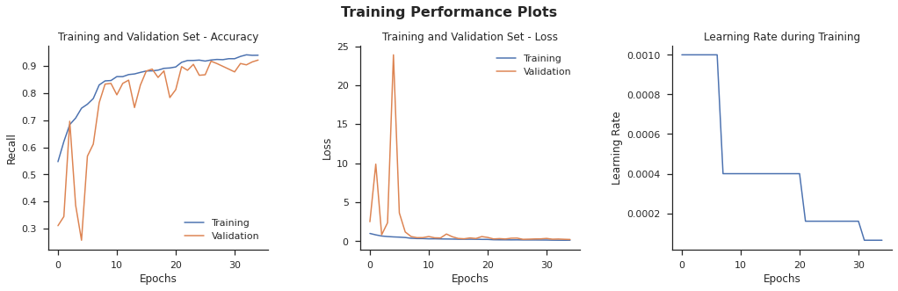
Results

Slide 14
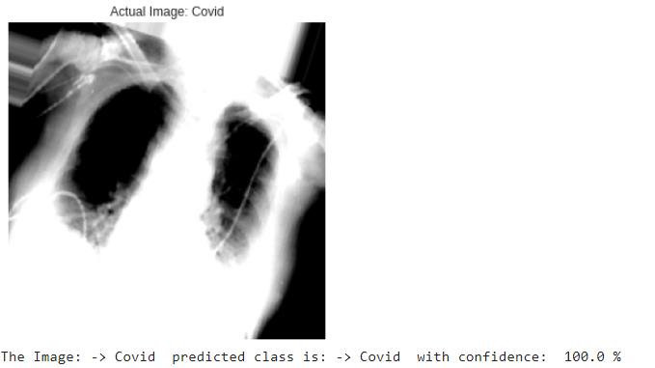
Results

Slide 15
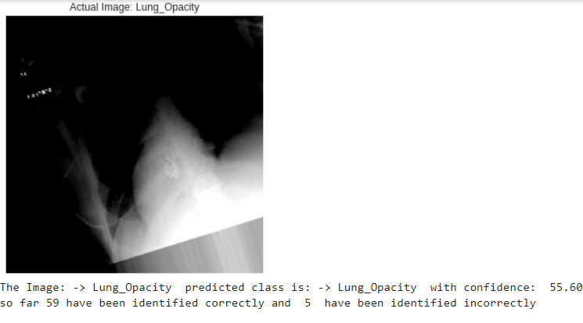
Results
64 Images were tested randomly
5 were classified wrongly and 59 images were classified correctly, giving the accuracy of 92.18 %

Slide 16
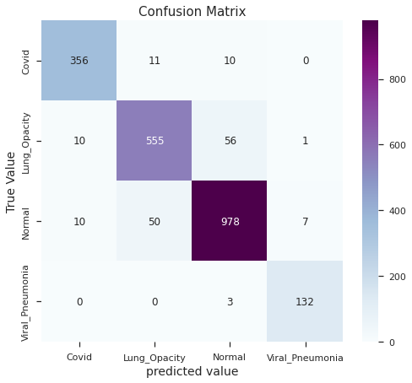
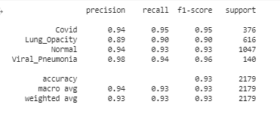
Confusion Matrix & Classification Report

